Slide 1
Final Project
By Masyn Grisel

Slide 2
Artifact
My artifact is a prediction tool for baseball teams that can be used to evaluate a team’s strengths and weaknesses along with their opponent’s strengths and weaknesses
This is done by combining many metrics, such as past performance, weather, game time, and statistical measures that impact the game like ERA(Earned Run Average), and generating a score that reflects predicted performance.

Slide 3
Purpose
The purpose of this artifact is to better prepare a team for their upcoming games. This can be done in many ways because there are many factors that are taken into account.
Traditionally, teams will just focus on the areas they have been struggling in according to their stats in the last 5-10 games and nothing else. With my artifact, a team can use data that is often overlooked combined with data that is already used to prepare for a game and prepare for their opponent.

Slide 4
How it Applies- Business Analytics
Business Analytics is the first component of this artifact. I have used statistics and analytics in different areas and combined them to generate a prediction score. I have also weighted and normalized the scores to create a score that is on a scale of 0-1 to for each team and creates the score based on the importance of each metric.

Slide 5
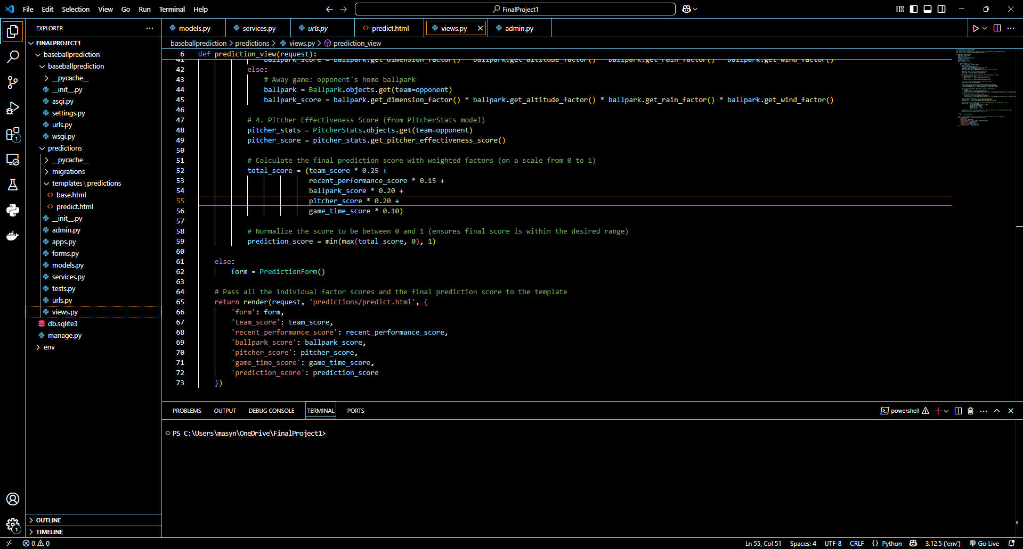
Example: Team score is given 25% of the total weight because it is the most commonly used indicator of a team’s performance. Team score is calculated using the team’s wins and losses and average runs scored and average runs allowed. Recent performance score is given 15% because it is not the strongest indicator, but still important. This takes data from a team’s last 5 games and gives them a score accordingly. For example, if a team has a win percentage greater than 70% for the last 5 games, they are given a score of 1.0, while a team with a 40-70% win percentage is given a score of 0.5. Ballpark score is 20% of the weight and is calculated based on the dimensions and weather of a ballpark. Pitcher score is 20% and is calculated based on the opposing pitcher’s stats compared to league average and the past performance of the given team against this opposing pitcher. Game time score is 10% and is calculated based on a team’s win percentage in day and night games.

Slide 6
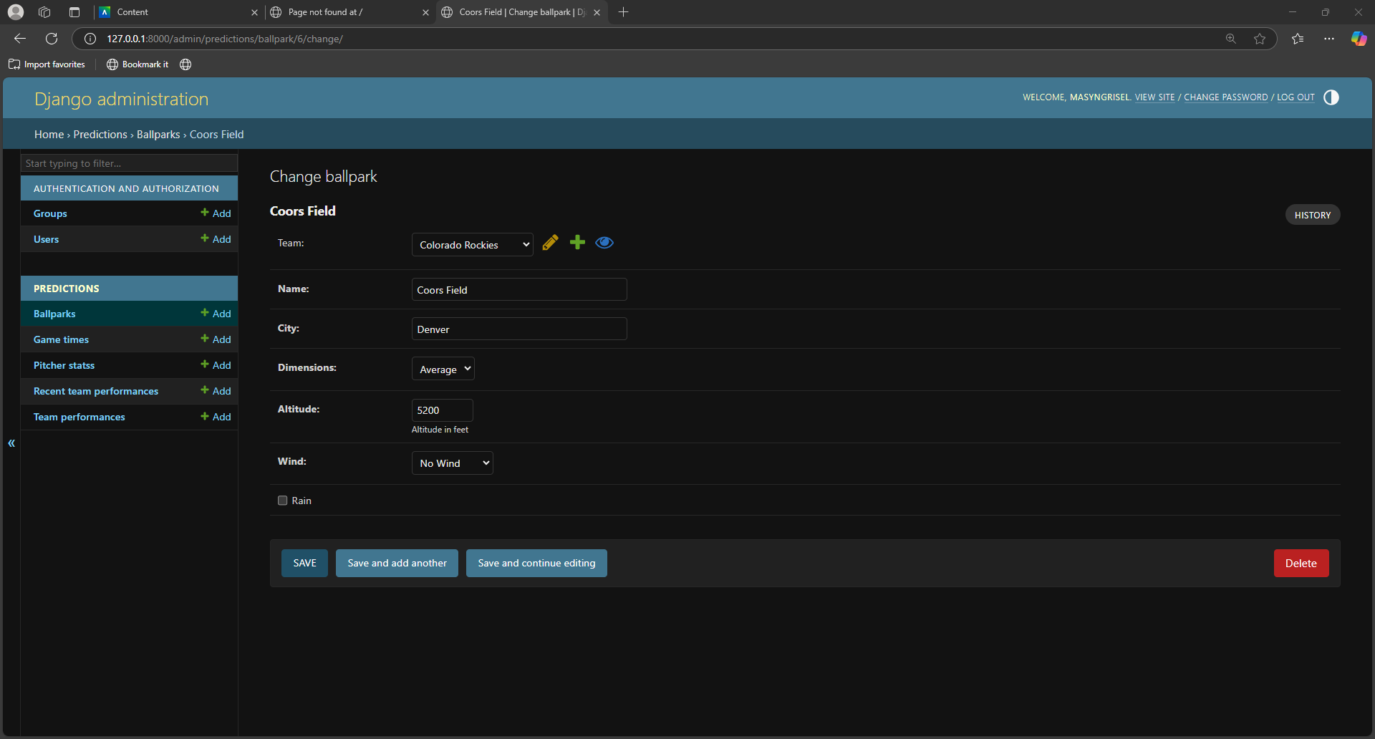
Data Management
To effectively run this model, all the data has to be stored in a way that is easily accessible and accurate. Below is a picture of the storage of all the data along with how it is stored.

Slide 7
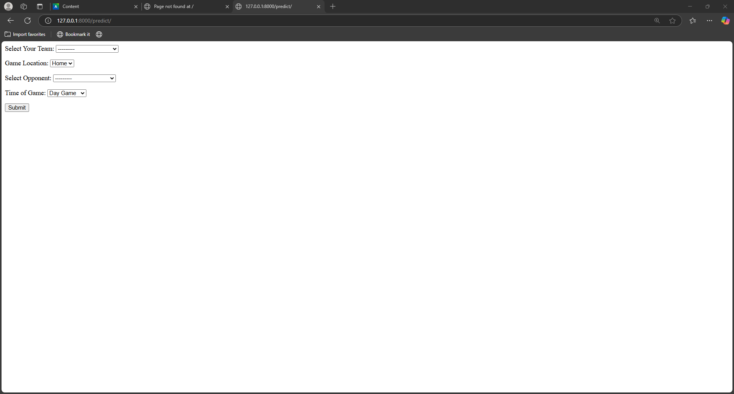
Systems Development
This tool will be ran using Django and be user friendly allowing team’s to easily select their information and interpret the results. This is how I turn all the data and formulas into a tool that I can offer to any organization.

Slide 8
Cybersecurity/Networking
Once this artifact is fully deployed and ready for use, I will add user authentication to prevent unwanted access across this tool. This will allow me to ensure only people who I want to use this tool will be able to use it.

Slide 9
Prediction Example
Below is an example of the Texas Rangers prediction for a home game at night against the Seattle Mariners. As you can see, the Rangers have not had much success in any category except pitcher effectiveness. This is because the pitcher for the Rangers is one of the best and, as a team, they have hit above average against their opposing pitchers. The generated total score is 0.55 out of 1. This would allow a team to see their weaknesses, address them, and hopefully beat their prediction score. The main goal of this is to be aware of any weaknesses, especially ones that are not commonly thought of.

Slide 10
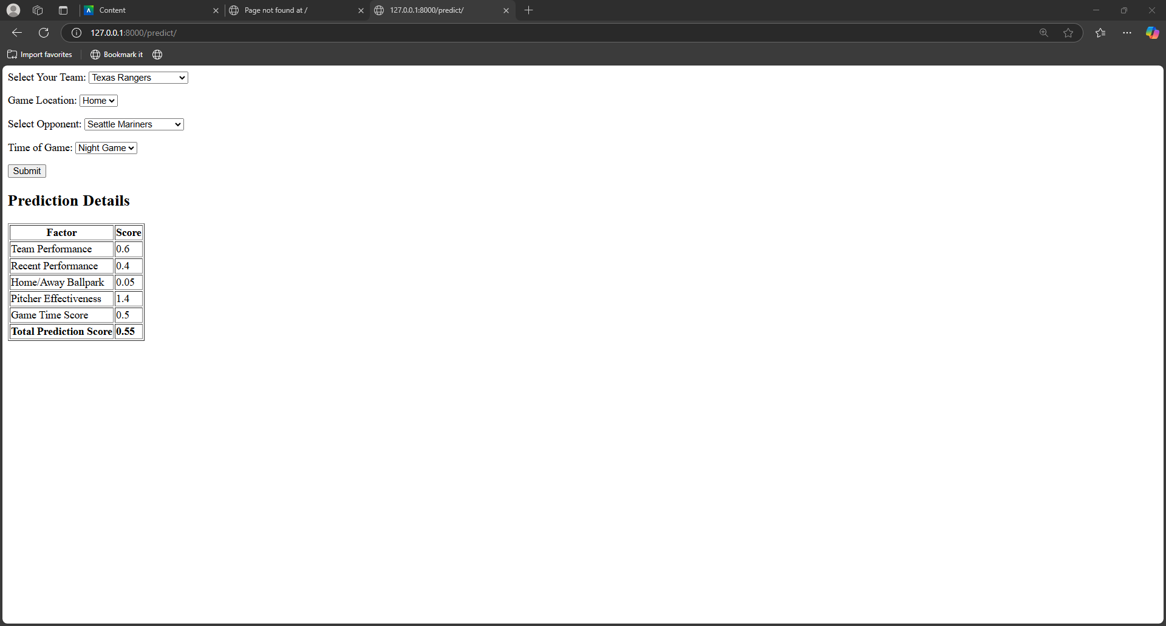

Slide 11
Conclusion
In conclusion, this artifact is very valuable to any organization trying to gain a competitive advantage. Analytics has become a major part of the way baseball is played today, and this tool combines all curriculum areas to benefit a team in ways they might not have known of. The artifact presented is just a small model, but you can see the possibilities given the proper time and resources.

